Slide 1


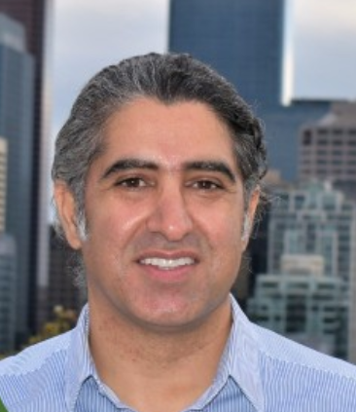

Hotspotters Geothermal Presentation
Crystal Zhao, Associate Machine Learning Developer
James Hiu, Data Consultant
Payam Akto, Geothermal Geologist
Tony Peng, Development Engineer

Slide 2
Overview
Case Statement
Technical Requirements
Other considerations
Insights and Discoveries
Summarize the work
Introduce the scenario and our approach
Summarize the data procedures and areas for objective assessment
discuss the business, social, technology and environment needs
Summarize our key insights and recommendations
Describe areas for future work and consideration
1
2
3
4
5

Slide 3
Thermal Energy from retrofitting oil wells - What makes a well viable?
Case Statement-Problem?
Regulation
Technical Requirements:
Will the site provide enough energy?
How can we accurately assess the temperature of the oil well?
Business development needs:
What are some of the operational and technology decisions?
Social impacts:
How many people will the produced energy serve?
Environmental impacts:
What are the effects to the natural environment and wildlife?
Social
Business
Science
(Temperature)
Environmental

Slide 4
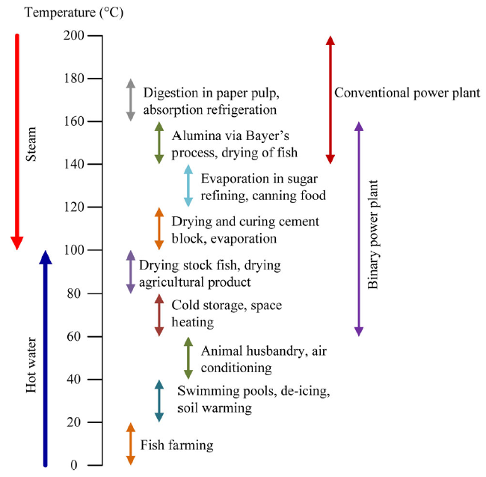
Practical Needs - Will the well provide Energy?
Lindal's diagram of geothermal energy usage denotes that
60ºC+ would be viable for binary power
140ºC+ would be viable for conventional power
We are provided temperature information for each well (BHT), but the analysis is not that simple
Notes:
EDA is the process of looking

Slide 5
Practical Needs - How to accurately determine a well’s temperature?
•We used an iterative process, project pipeline, build an accurate and predictive model.
Generating Model and Explainability
Feature Engineering Process
A
B
C
D
Iteration
Exploratory Data Analysis
Modeling Process

Slide 6
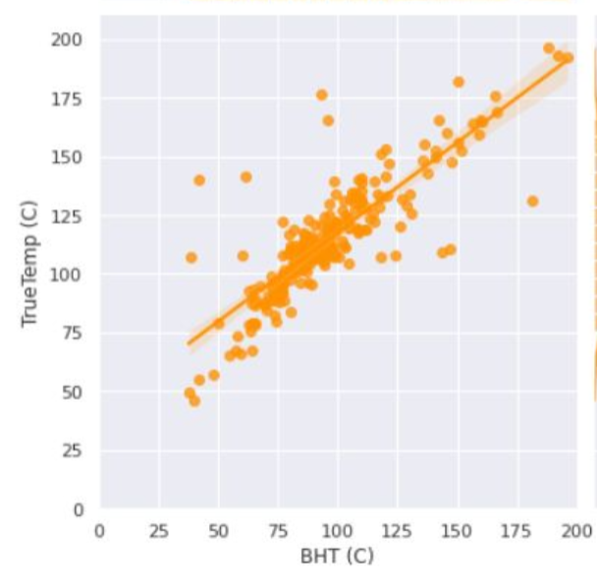
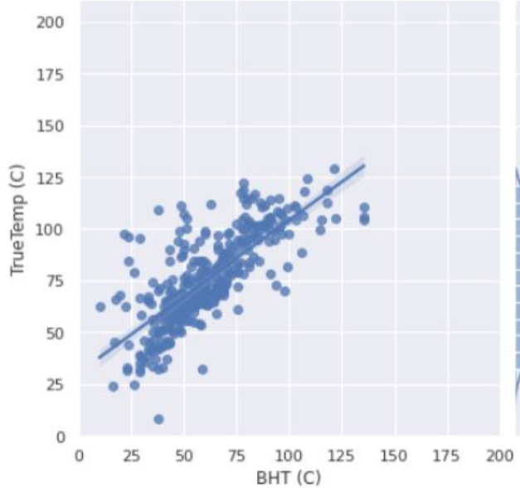
Perform Exploratory Data Analysis
Examine the information we were provided for strong correlations
Four promising features were found, common to both basins
Important features specific to individual basins were also discovered
Eaglebine
Duvernay
Eaglebine TrueTemp vs BHT
Duvernay TrueTemp vs BHT
Measured Temperature
Subsea - Depth
Latitude
Longitude
TSC or ORT
Test Type
Pearson Correlation=0.84
Pearson Correlation=0.75
Notes:
TSC or ORT -time since circulation or original recorded time
Test Type - DST, LRT, CRS

Slide 7
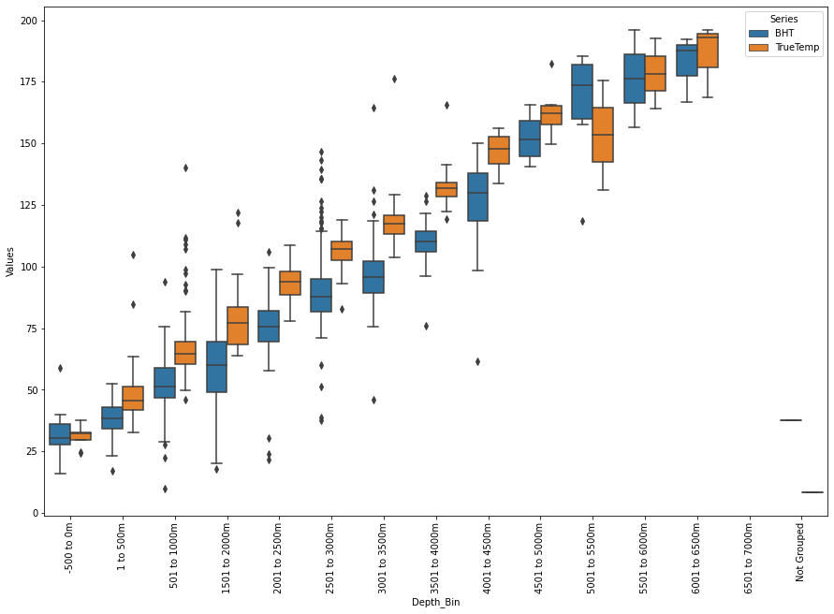
Feature Engineering and Outlier Reduction
Outlier treatment enhanced model accuracy
Grouped wells into 500 meter sub-sea-level depth ranges and looked for wells in ranges that were too cold or too hot with comparable wells

Slide 8
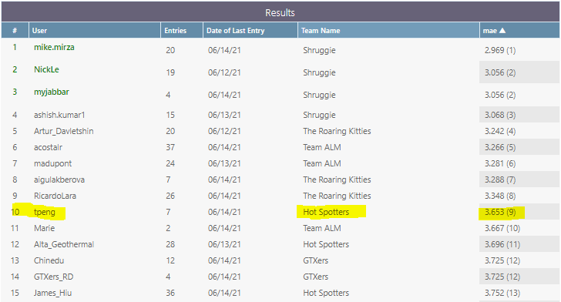
Modeling PerformanceSummary
The best performing model scored 3.65 MAE
Applying Gradient Boosting Regressor to the Duvernay and Eaglebine dataset separately

Slide 9
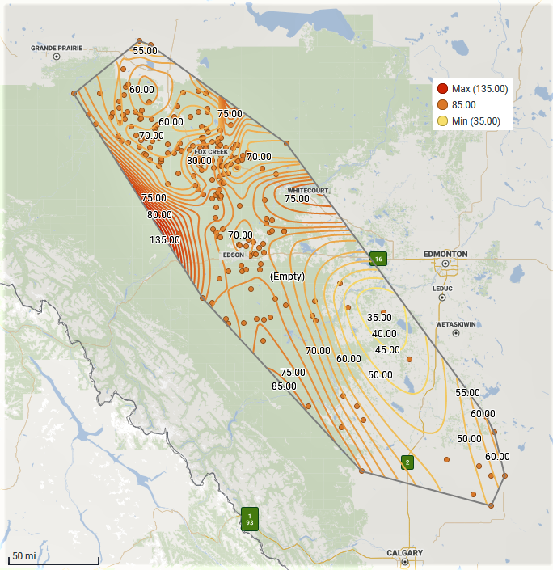
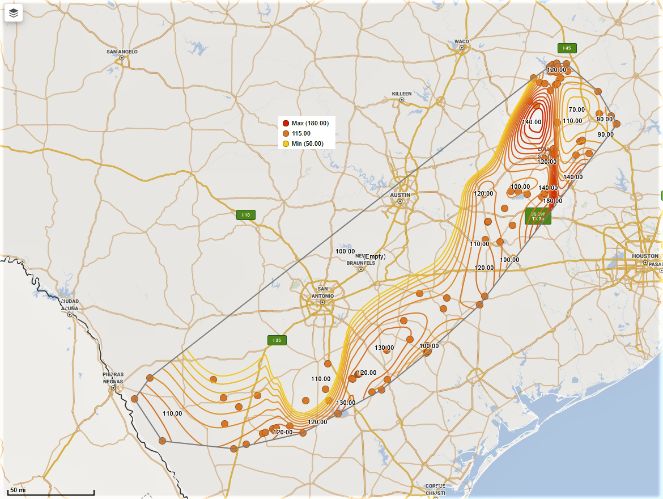
Comparing Geothermal Potential Between Basins
Duvernay Play, Alberta, Canada
Eaglebine Play, Texas, US
Type of System: low-temperature, sedimentary
Av. Thermal Gradient : 31.6 ºC/km
Av. Temperature: 61.1 ºC @2km
Av. Formation Gross Thickness: 380m (Beaverhill lk., Elk pnt. G.)
Av. Elevation: 1,020 m (Wabamun G.)
Volumetric Modeling (stored heat): 56.7 MWe
Type of System: low-temperature, sedimentary, geopressured
Av. Thermal Gradient: 35.5 ºC/km
Av. Temperature: 95 ºC @2.7km
Av. Formation Gross Thickness: 538m (Woodbine F.)
Av. Elevation: 2,223 m (Buda and underlaid)
Volumetric Modeling (stored heat): 151.3 MWe

Slide 10
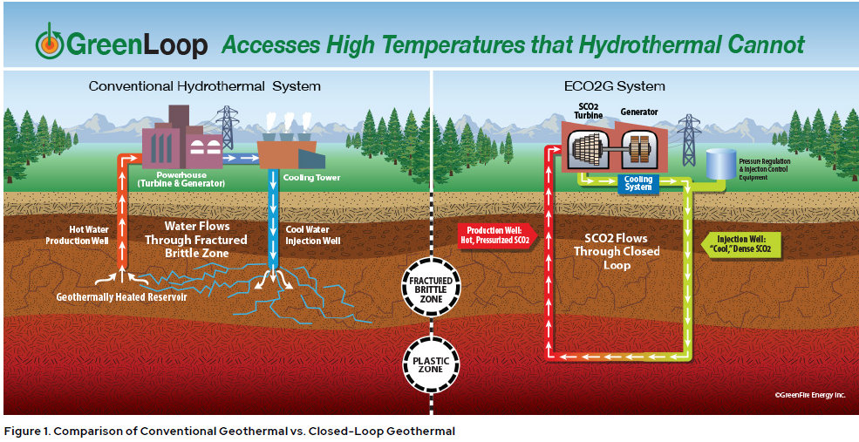
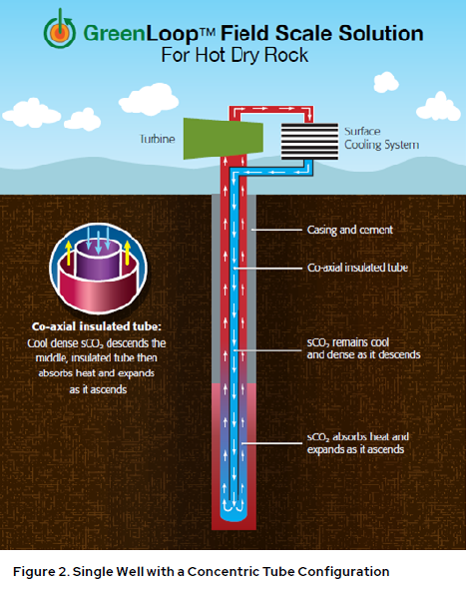
Operational Needs: Retrofitting Technology Considerations
1- Heat extraction - open loop performs better than closed loop
2- Lower Temperature wells, consider drilling deeper or using a lower boiling point liquid.
3- Closed loop, business benefit of no additional drilling
Open-loop vs Closed-loop

Slide 11
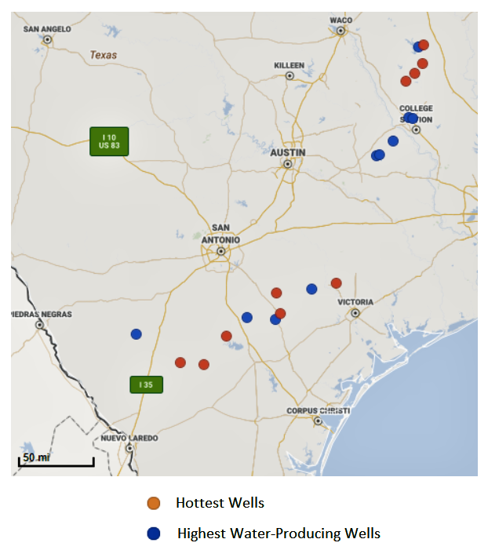
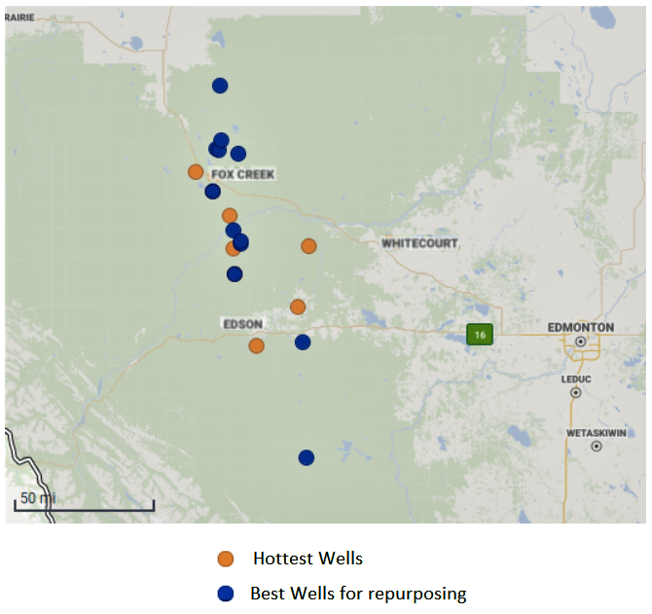
Business Needs: Which are the best Candidate Wells?
Eaglebine Play, Texas, US
Duvernay Play, Alberta, Canada
Prospect Area: E Edson, Fox Creek
Prospect Area: S-SE San Antonio, E-NE Austin

Slide 12
Socio-Economic Impacts
Alberta, CAN vs. Texas, US
Accessibility to market and energy demand (end-user needs)
Population: 29 million, 2019
Advocative regulation and policy
more mature regulatory framework in petroleum industry (ready to pivot quicker)
R&D Programs
Several R&D funds by Department of Energy
Successful projects
Several binary plants are generating power from low-temperature resource
Power grid and infrastructure
~75,000 km of transmission lines and more than 550 generation units.
Accessibility to market and energy demand (end-user needs)
Population: 4.3 million, 2019
Advocative regulation and policy
no regulatory framework exist
R&D Programs
no significant R&D program (early stage)
Successful projects
no power generation (some projects at early stages- Alberta #1, DEEP, EAVER)
Power grid and infrastructure
~ 26,000 km of transmission lines and 235 generating stations.

Slide 13
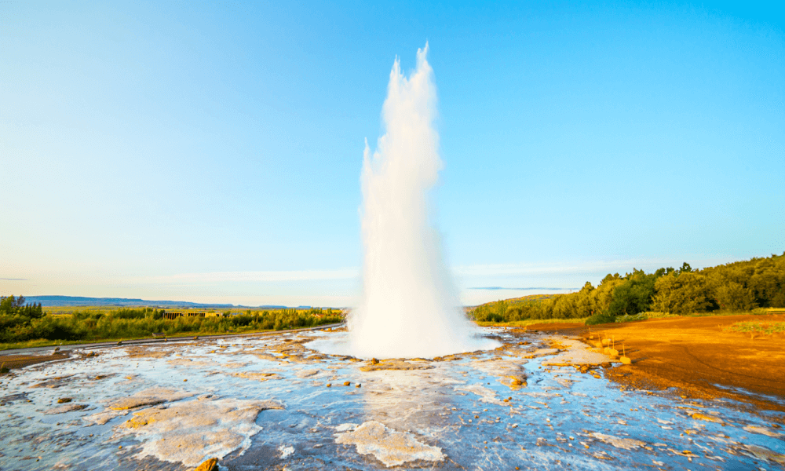
Environmental Impacts
Geothermal is a Green source of energy!
The energy source is available 24/7 compared to other green sources such as wind and solar
Near zero greenhouse gas emissions (50g of CO2 over a 30-year project lifespan)

Slide 14
Data Wish List
Business Considerations
The cost of retrofitting an oil well into a geothermal energy plant The cost of operating the geothermal energy plant The estimated revenue that could be generated producing this type of energy Potential cost sharing from oil company that would be in charge of decommissioning the well. Potential for political funding/tax benefits due to green energy / job creation initiatives
Social Impacts
The estimated number of jobs created at the plant The estimated number of jobs displaced by the creation of the plant The cost savings to potential customers consuming this type of energy
Environmental Impacts
The estimated cost savings from environmental damage¹ Noise level and proximity to local population. Ground temperature change and and impacts to plant and wildlife. Compared to a conventional geothermal well development project, savings in terms of: - deforestation (sq. miles) - disposal of waste liquid

Slide 15
References
1 King GE, Valencia RL. Environmental Risk and Well Integrity of Plugged and Abandoned Wells. Paper presented at SPE Annual Technical Conference and Exhibition, 27-29 October, Amsterdam, The Netherlands Society of Petroleum Engineers;2014. https://doi.org/10.2118/170949-MS
2.Jundika CK, Muhammad SS, Zulfan AP,Juliana Z, Wahyu C, Agus PS. Geothermal energy extraction using abandoned oil and gas wells: Techno-economic and policy review

Slide 16
APPENDIX

